Slide 1
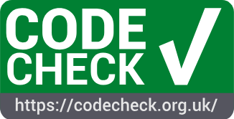

Code execution in peer review for your favourite conference or journal with CODECHECK
NFDI_BB meeting May 2026 (doi.org/10.25798/gmzb-cd87)
2026-05 | Daniel Nüst | orcid.org/0000-0002-0024-5046
Slides: doi.org/10.5281/zenodo.20084769
This work is published
under a CC-BY 4.0 license.
Notes:
Should be “inspiring”

Slide 2

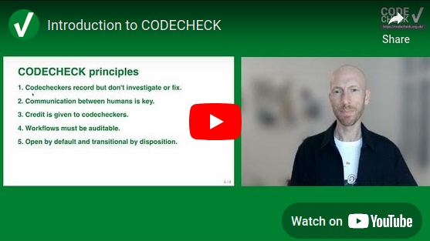
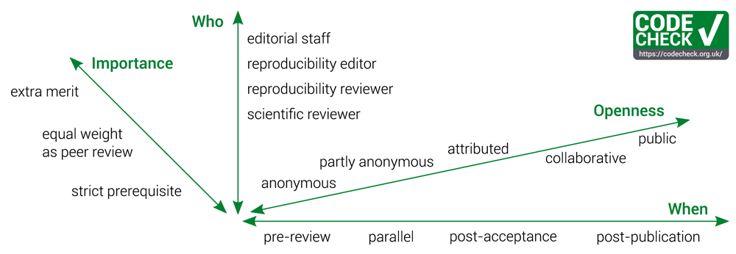

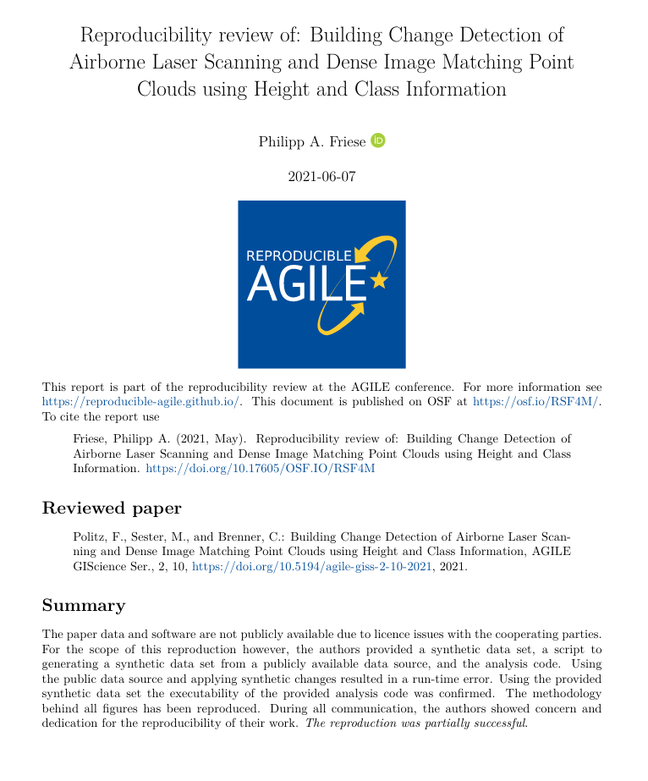
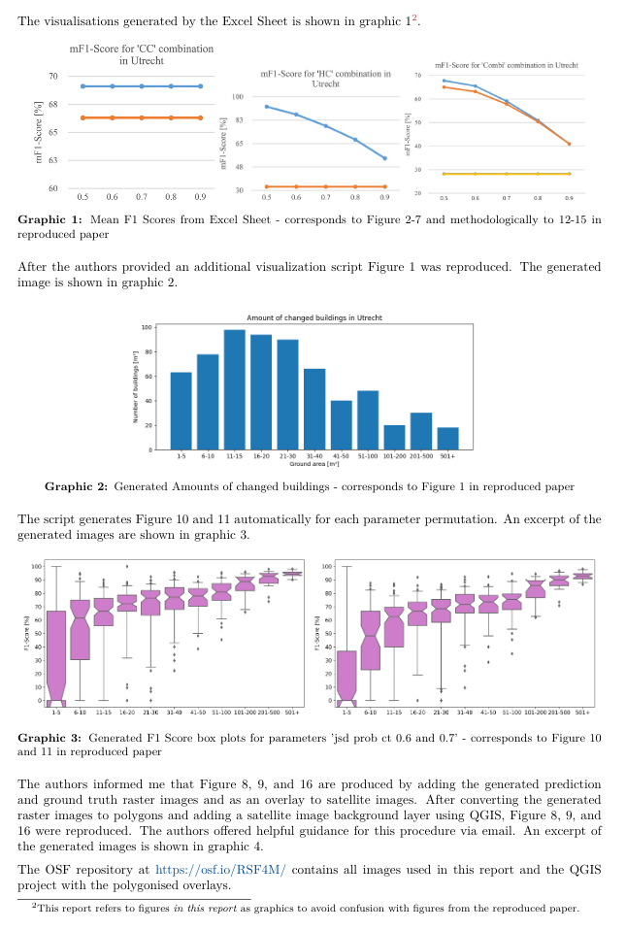
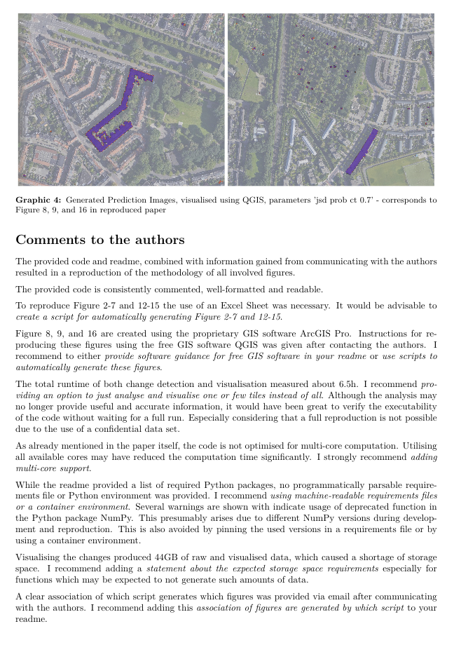

One re-execution of computational workflow by codechecker during scholarly communication, review & publication
Codecheckers record but don’t investigate or fix.
Communication between humans is key.
Credit is given to codecheckers.
Workflows must be auditable.
Open by default and transitional by disposition.
Independent execution of computations underlying research articles.
🧑‍🎓🛠️
🔏
100+ Certificates https://codecheck.org.uk/register/
The CODECHECK variations. Figure 1 of https://doi.org/10.12688/f1000research.51738.1
Notes:
A CODECHECK means that a single person, the codechecker, is able to execute a computational workflow at one point in time using the material provided by the author. The codechecker should not get relevant errors doing so, and get results that are not contradicting the original results. This is by design a very limited scope. It places little burden on the authors - they share what they have, and puts the trust in a person instead of requiring infrastructure or technological expertise. Just like peer review puts its trust in researchers as reviewers. CODECHECK’s scope gives flexibility, no standards or specific infrastructure is needed.
CODECHECK is built on five principles: [...]
If a CODECHECK is completed, there is a badge
and a certificate that we publish in a citable way with a DOI.
To date, 30 such certificates have been published, in which the codechecker shares their personal evaluation openly and transparently.
A CODECHECK can be implemented in many ways, varying depending on the existing procedures of journals or common community practices.
It can not only happen at different points in time or varying degrees of openness and power or importance, but also can be completed by different roles. Especially
early career researchers could be excellent candidates to be introduced to peer reviewing in this way. More importantly, they often have the required up-to-date expertise in technology and a large interest in learning methods, not just evaluating them. And the learning experience is one of the main motivation we are told that volunteer codecheckers are interested in, and one I can personally confirm - if you reproduce someone else’s work, you always learn something, and always can contribute back something.
-------------------------
1. Codecheckers record but don’t investigate or fix.
The codechecker follows the author’s instructions to run the code. If instructions are unclear, or if code does not run, the codechecker tells the author. We believe that the job of the codechecker is not to fix these problems but simply to report them to the author and await a fix. The level of documentation required for third parties to reproduce a workflow is hard to get right, and too often this uncertainty leads researchers to give up and not document it at all. The conversation with a codechecker fixes this problem.
2. Communication between humans is key.
Some code may work without any interaction, e.g. 21, but often there are hidden dependencies that need adjusting for a particular system. Allowing the codechecker to communicate directly and openly with the author make this process as constructive as possible; routing this conversation (possibly anonymously) through a publisher would introduce delays and inhibit community building.
3. Credit is given to codecheckers.
The value of performing a CODECHECK is comparable to that of a peer review, and it may require a similar amount of time. Therefore, the codechecker’s activity should be recorded, ideally in the published paper. The public record can be realised by publishing the certificate in a citable form (i.e., with a DOI), by listing codecheckers on the journal’s website or, ideally, by publishing the checks alongside peer review activities in public databases.
4. Workflows must be auditable.
The codechecker should have sufficient material to validate the workflow outputs submitted by the authors. Stark²² calls this “preproducibility” and the ICERM report¹¹ defines the level “Auditable Research” similarly. Communities can establish their own good practices or adapt generic concepts and practical tools, such as publishing all building blocks of science in a research compendium (cf. https://research-compendium.science/) or “repro-pack”²³. A completed check means that code could be executed at least once using the provided instructions, and, therefore, all code and data was given and could be investigated more deeply or extended in the future. Ideally, this is a “one click” step, but achieving this requires particular skills and a sufficient level of documentation for third parties. Furthermore, automation may lead to people gaming the system or reliance on technology, which can often hide important details. All such aspects can reduce the understandability of the material, so we estimate our approach to codechecking, done without automation and with open human communication, to be a simple way to ensure long-term transparency and usefulness. We acknowledge that others have argued in favour of bitwise reproducibility because, in the long run, it can be automated (e.g., https://twitter.com/khinsen/status/1242842759733665799), but until then we need CODECHECK’s approach.
5. Open by default and transitional by disposition.
Unless there are strong reasons to the contrary (e.g., sensitive data on human subjects), all code and data, both from author and codechecker, will be made freely available when the certificate is published. Openness is not required for the paper itself, to accommodate journals in their transition to Open Access models. The code and data publication should follow community good practices. Ultimately we may find that CODECHECK activities are subsumed within peer review.

Slide 3
AGILE conference success story
From zero to reproducible in
countable steps and observable time

Slide 4
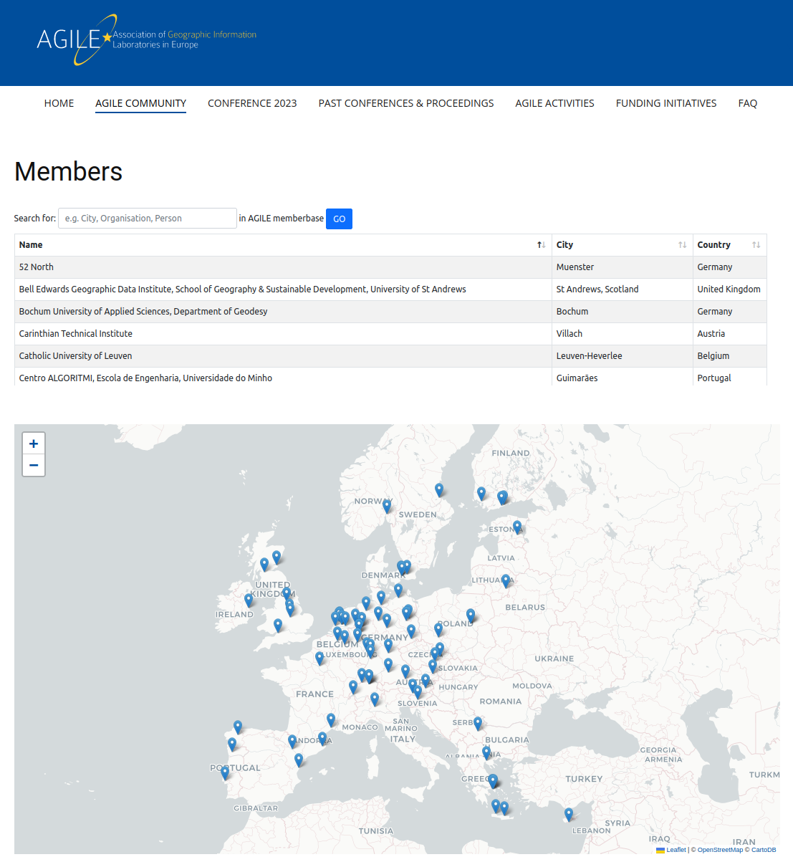
Who is AGILE?
https://agile-gi.eu/
Notes:
community-led conference

Slide 5
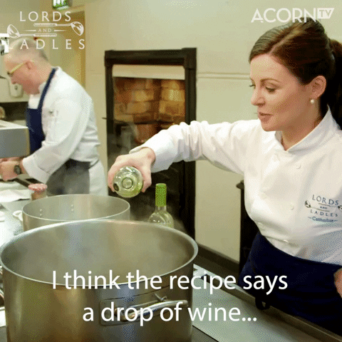
From AGILE to your community
3 transferable ideas:
human-centered process, communicative focus, supportive framework of tools and infrastructure.
https://giphy.com/gifs/acorn-tv-wine-cooking-recipe-BhsSZR0k6EMxjCQDwP
Notes:
https://giphy.com/gifs/cbc-funny-comedy-xT9IgzFnSqzt2Sp3EI

Slide 6
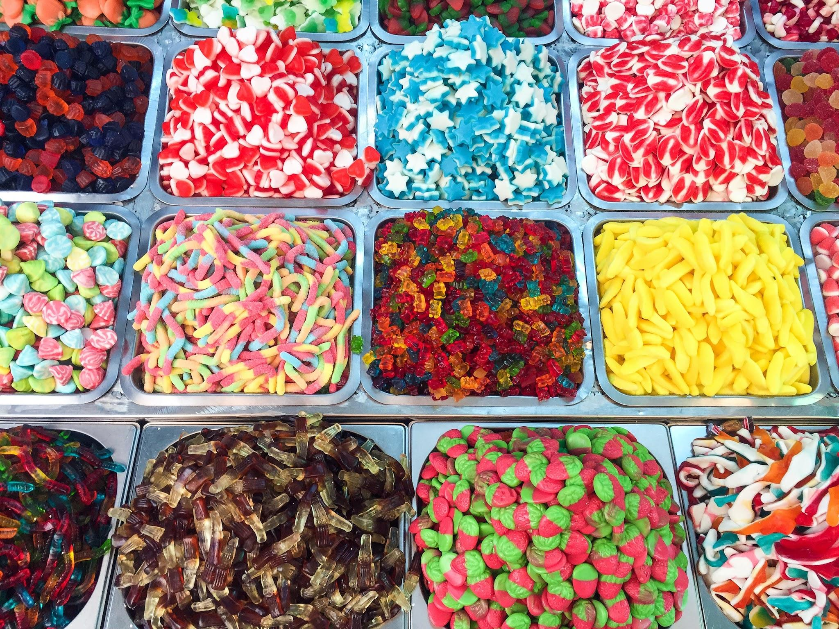
‏‏‎ ‎Human-centered process for ‎
‏‎‎reproducibility handles variety‎‏‏‎ ‎
Author provides material and makes fixes
Collaborate to make things work
Codechecker stops when confident enough all parts are provided and then gives review
Photo JACQUELINE BRANDWAYN | Unsplash
Notes:
First, Reproducible AGILE’s human-centered process is able to handle the increasingly complex, large and varying data-based workflows in ESS because of the clear guidance on responsibilities
What should the author provide?
How far does the reproducibility reviewer need to go?
Large data? Bespoke script? Latest tool version? Niche compiler?

Slide 7

‎Communicative focus for reproducibility.
Avoids rules & automation playing catch with innovation & technology
Avoids unification or limitation of researcher freedom
Continuous development of shared practice over time
& definition of “reproducibility” and “how reproducible is enough"
Targets attitudes towards sharing, transparency, and openness
Positive learning experience for all involved roles
Photo by Priscilla Du Preez | Unsplash
Notes:
Second, the communicative focus of the process is very well suited to, over time, help to establish a shared practice based on current technical developments, such as FAIR Digital Objects, and to reform attitudes towards openness, transparency and sharing. A code execution following the CODECHECK principles is a learning experience that may sustainably change researcher behaviours and practice. At the same time, Reproducible AGILE’s approach avoids playing catch-up with technology and does not limit researcher freedom or includes a need to unitise researcher workflows beyond providing instructions suitable for a human evaluator, similar to academic peer review.

Slide 8
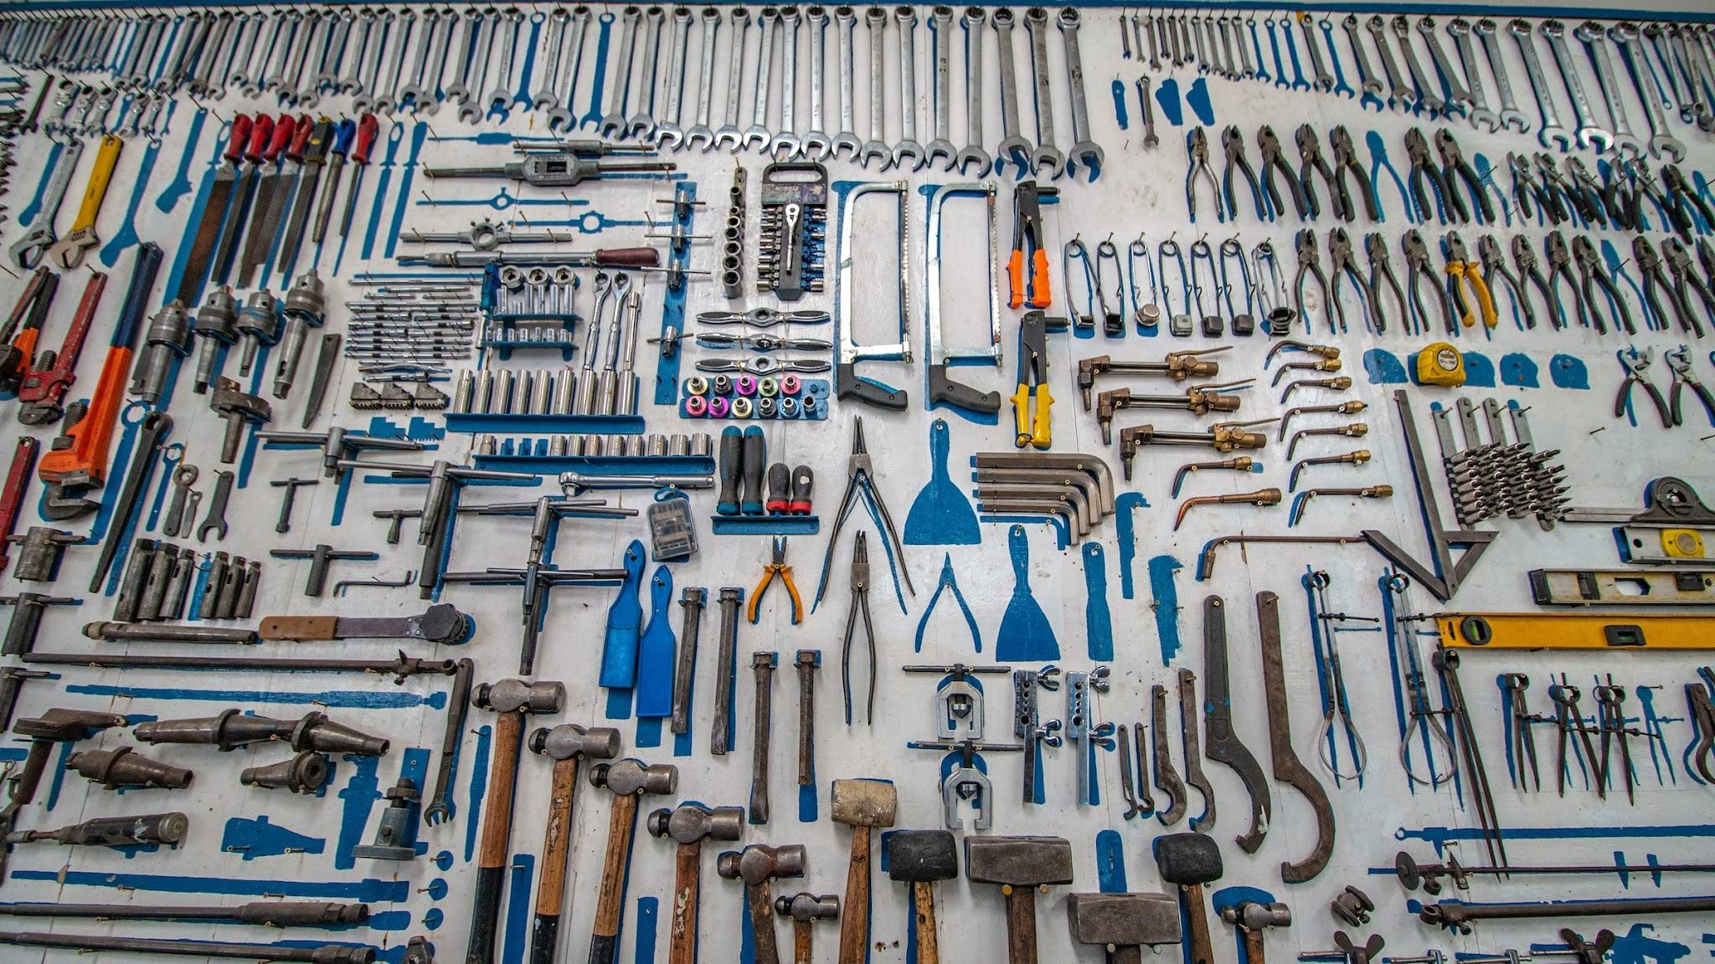
Tools & infrastructure for reproducibility.
Faster codechecking with…
Notebooks
Binder (BinderHub)
Open methods
(Small) reference datasets & demo pipelines
But works without!
Photo by Cesar Carlevarino Aragon | Unsplash
Notes:
Third, while being agnostic of technology and infrastructures, a supportive framework of tools and infrastructure can of course increase the efficiency of conducting a code execution. We outline how existing infrastructures may serve this need and what is still missing.

Slide 9

https://media.giphy.com/media/mbhseRYedlG5W/giphy.gif
What are the steps that you could take? Five year plan:
1️⃣ Initiate discourse with a core team in a
(small, sub) community (e.g., small event/workshop)
2️⃣ Document state of reproducibility &
find leadership support (metascience paper)
3️⃣ Establish guidelines (do-ocracy) &
apply to current work (preprints, post-pub)
4️⃣ Get leadership on board and introduce policy
stepwise
5️⃣ Continue positive discourse
Notes:
Build a team of enthusiasts (workshop, social events)
Assess the current state and raise awareness (workshop, paper)
Institutional support (🙏 AGILE Council 🙏 + committee chairs)
Positive encouragement (no reproduction != bad science)
Keep at it!

Slide 10
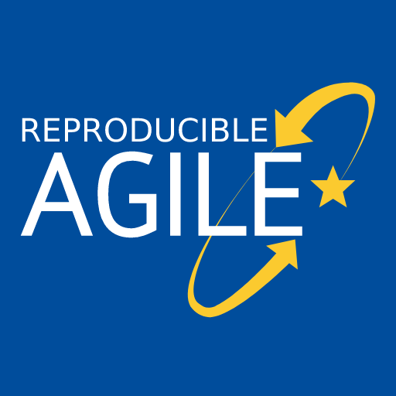
https://reproducible-agile.github.io/
2017, ‘18 & ‘19: Workshops on reproducibility
2019: Reproducible publications at AGILE conferences
(AGILE Initiative supported by AGILE Council)
2020: First AGILE reproducibility review
2021: Second AGILE reproducibility review
2022: Third AGILE reproducibility review - guidelines mandatory
2026: Still going, desk reject when no DASA section
Notes:
Two workshops in 2017 and 2018 and a piece of meta-research into the reproducibility of papers published at the AGILE conference were the basis for a small group from the AGILE community to apply for an initiative to develop guidelines for reproducible publications. The AGILE council granted support for the initiative, and the guidelines were published shortly before the conference in 2019.
In 2020, the guidelines were for the first time recommended in the call for papers, and for the first time a reproducibility committee was put in place to evaluate the reproducibility of accepted papers. Find out more at the Reproducible AGILE website.
Today, I will introduce the Reproducible Paper Guidelines. Then, I’ll talk about the reproducibility review process at the last conference in detail and try to summarise the results and lessons learned in a way that makes them useful to other communities.

Slide 11
Thanks!
Questions?

Slide 12
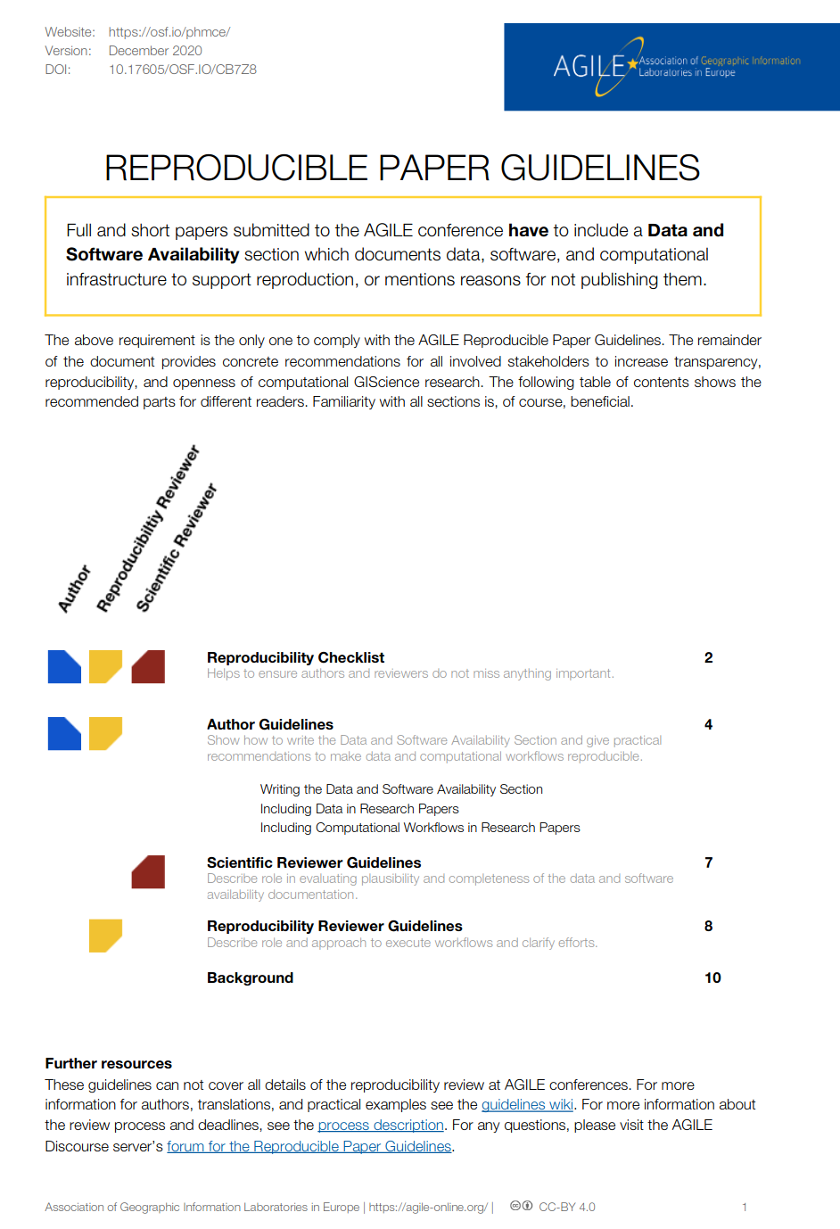
AGILE Reproducible Paper Guidelines 🇬🇧 🇪🇸 ^{(v1)} https://doi.org/10.17605/OSF.IO/CB7Z8
Created by AGILE Initiative in 2019 (see report at https://osf.io/hupxr/) and updated in 2020
Transparency over
enforcement
Promote, don’t exclude
Acknowledge spectrum and striving for ideal
Tailored to GIScience
Notes:
In 2019, AGILE supported an initiative for developing guidelines for reproducible papers.
These guidelines are the first compilation of tipps and tools how to increase transparency in GIScience papers, including a wiki with examples for typical GIScience datasets and workflows.
Their intention is to promote positive examples of reproducible computational research.
Primarily, the guidelines include AUTHOR GUIDELINES, that is how to incorporate DATA and COMPUTATIONAL ​ WORKFLOWS​ IN RESEARCH PAPERS and a section on WRITING THE DATA AND SOFTWARE AVAILABILITY SECTION, or “DASA” section.
Having a DASA section is the only mandatory requirement! It is absolutely possible not to provide any links to data and code and comply with the guidelines at the same time.
These guidelines were put into the call for papers as a recommendation.

Slide 13
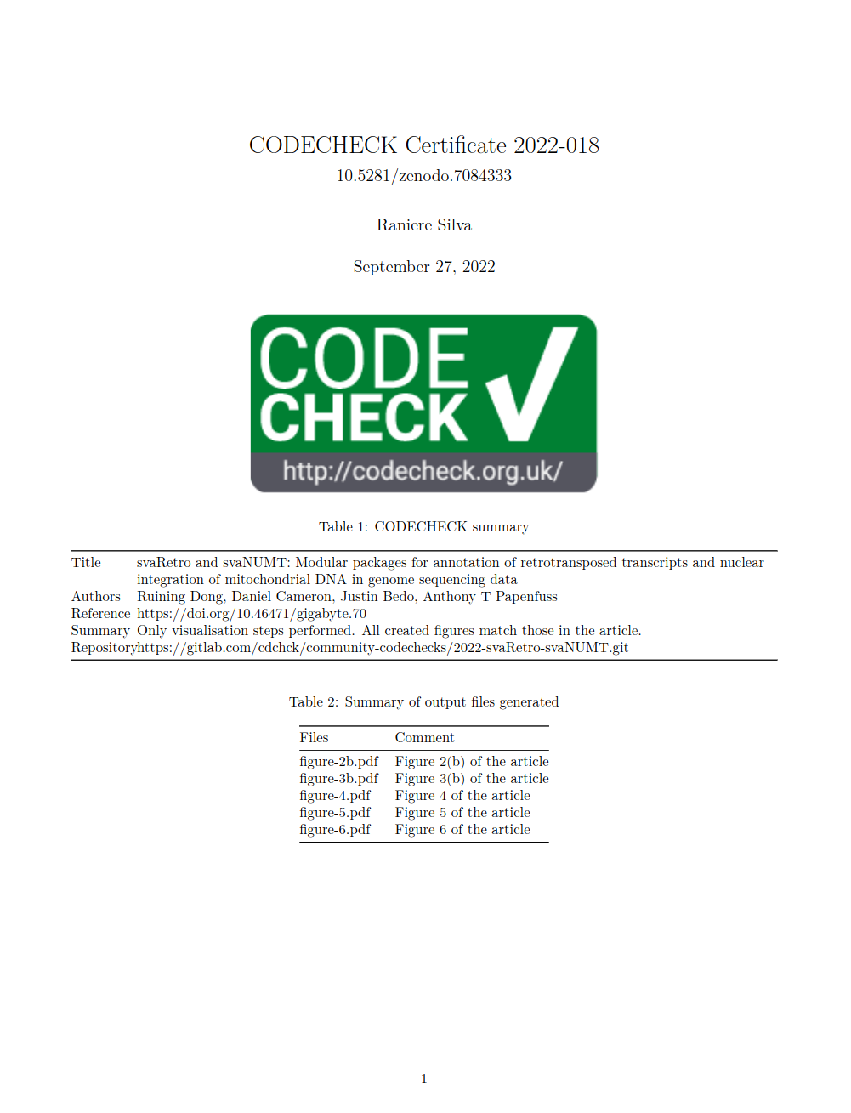
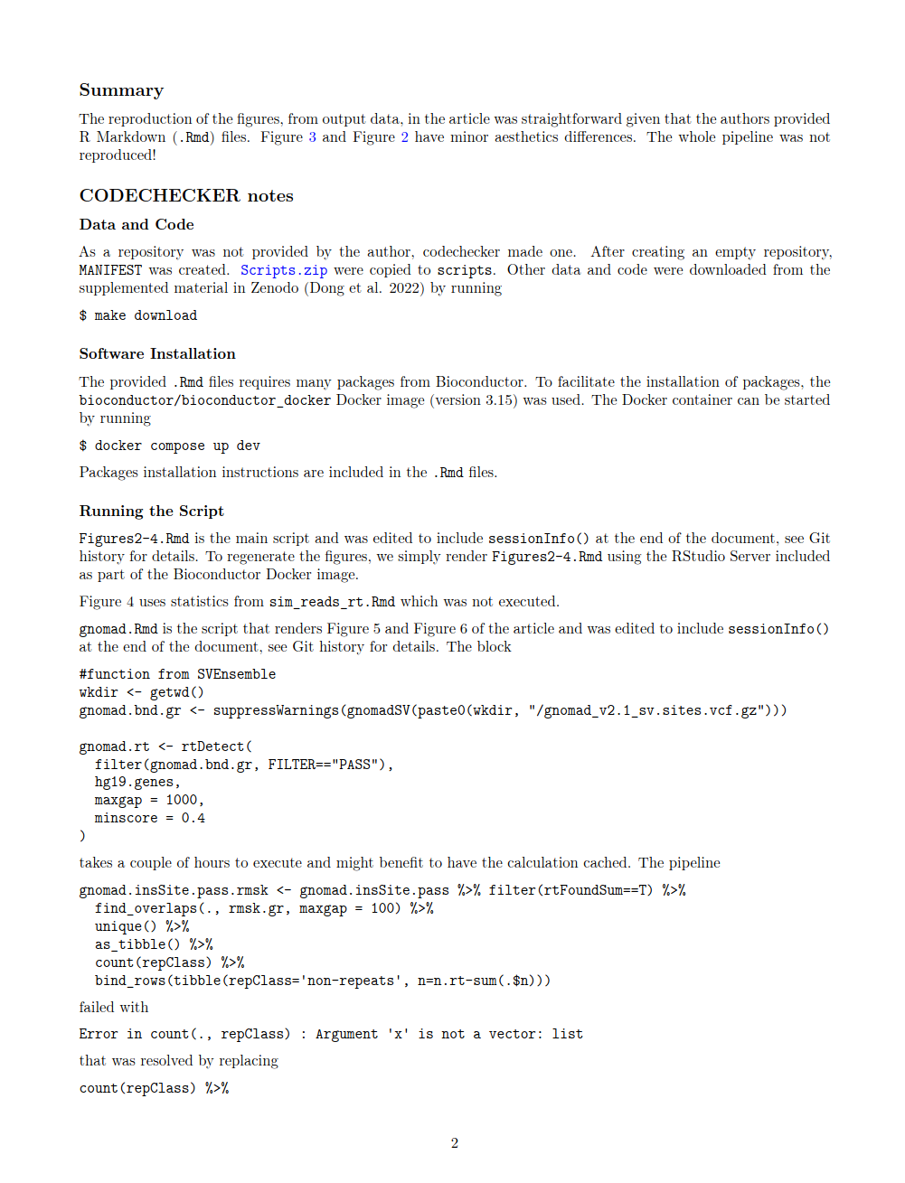
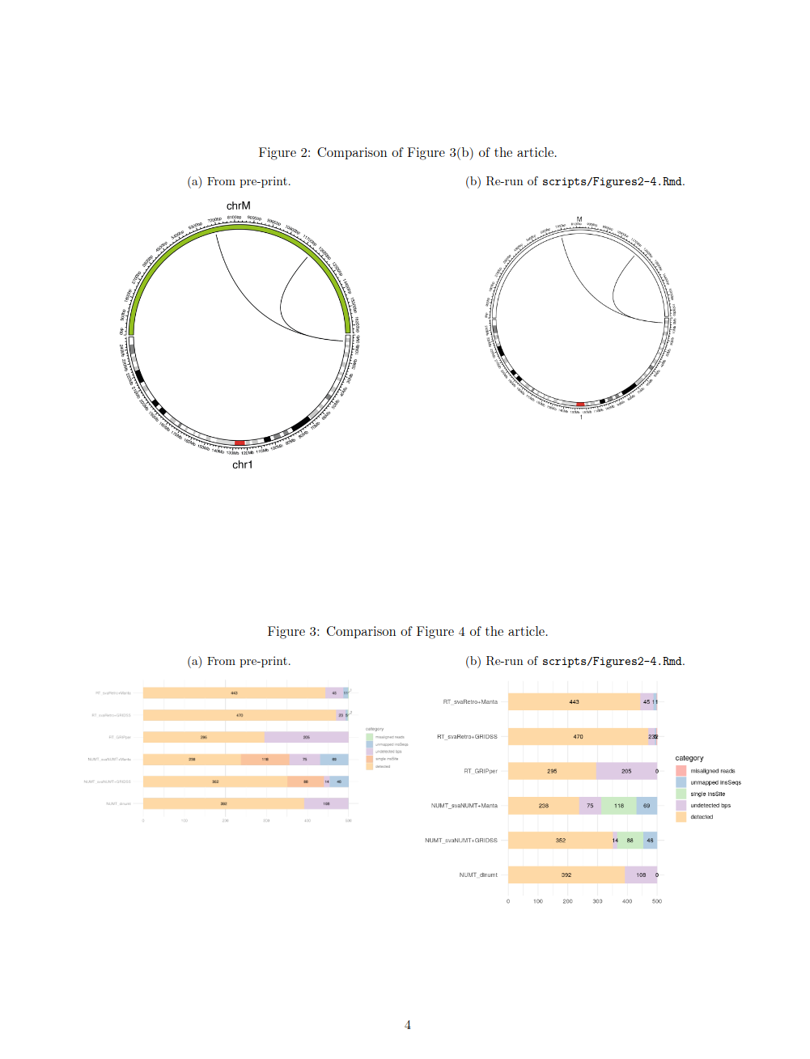
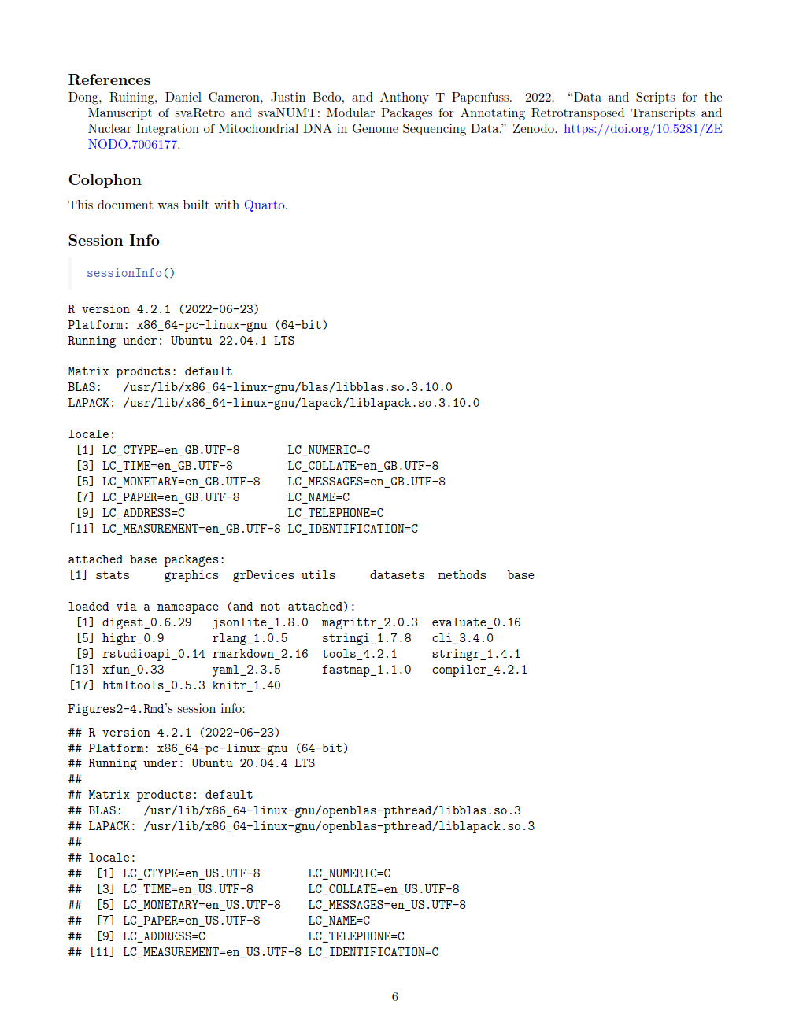
https://doi.org/10.5281/zenodo.7084333

Slide 14
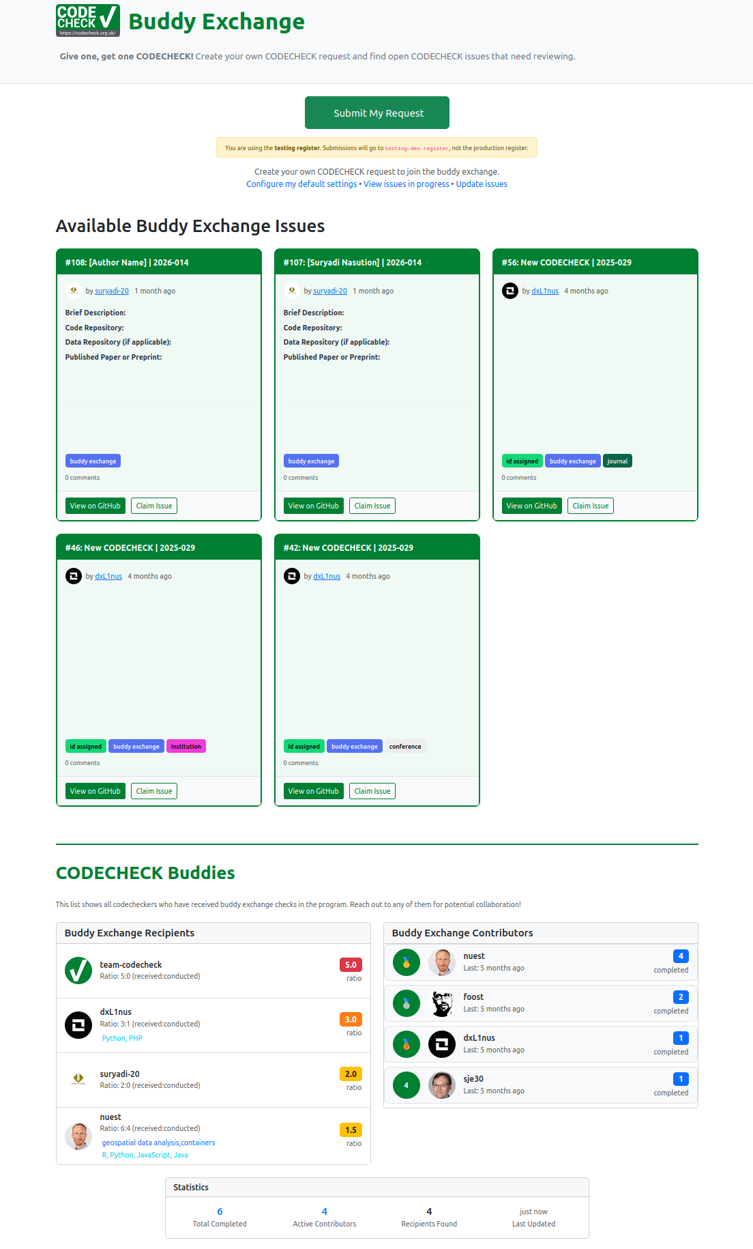
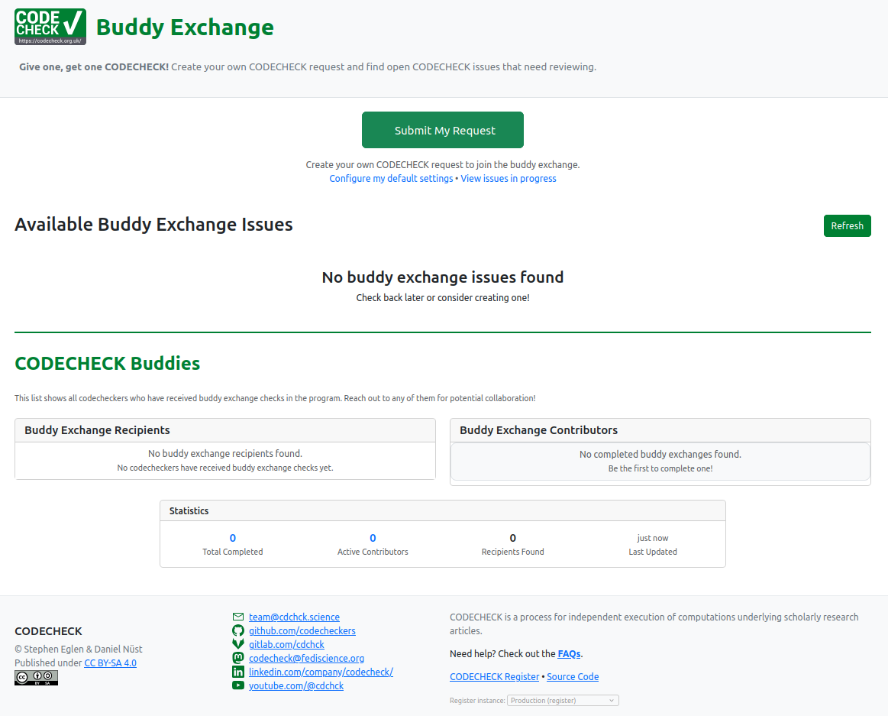
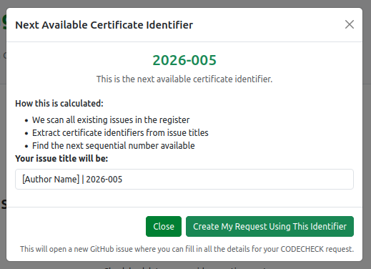
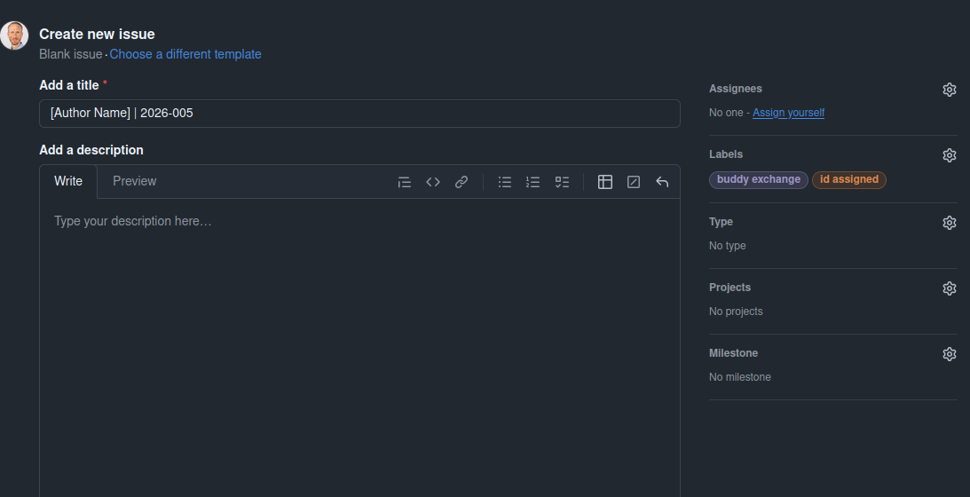
codecheck.org.uk/buddy-exchange
Give one, Get one.

Slide 15
CODECHECK Community Workflow
https://codecheck.org.uk/guide/community-workflow-overview
For authors
Have a README, find a suitable checklist to use, basic metadata in
codecheck.yml, licensing information; acknowledgement in manuscript
For codecheckers (short, extended, in-person events)
Handling repos/files, approaching a workspace/workflow,
responsibilities, writing the certificate;
it is a craft, so we mentor better than we write process descriptions!
For editors (me)

Slide 16
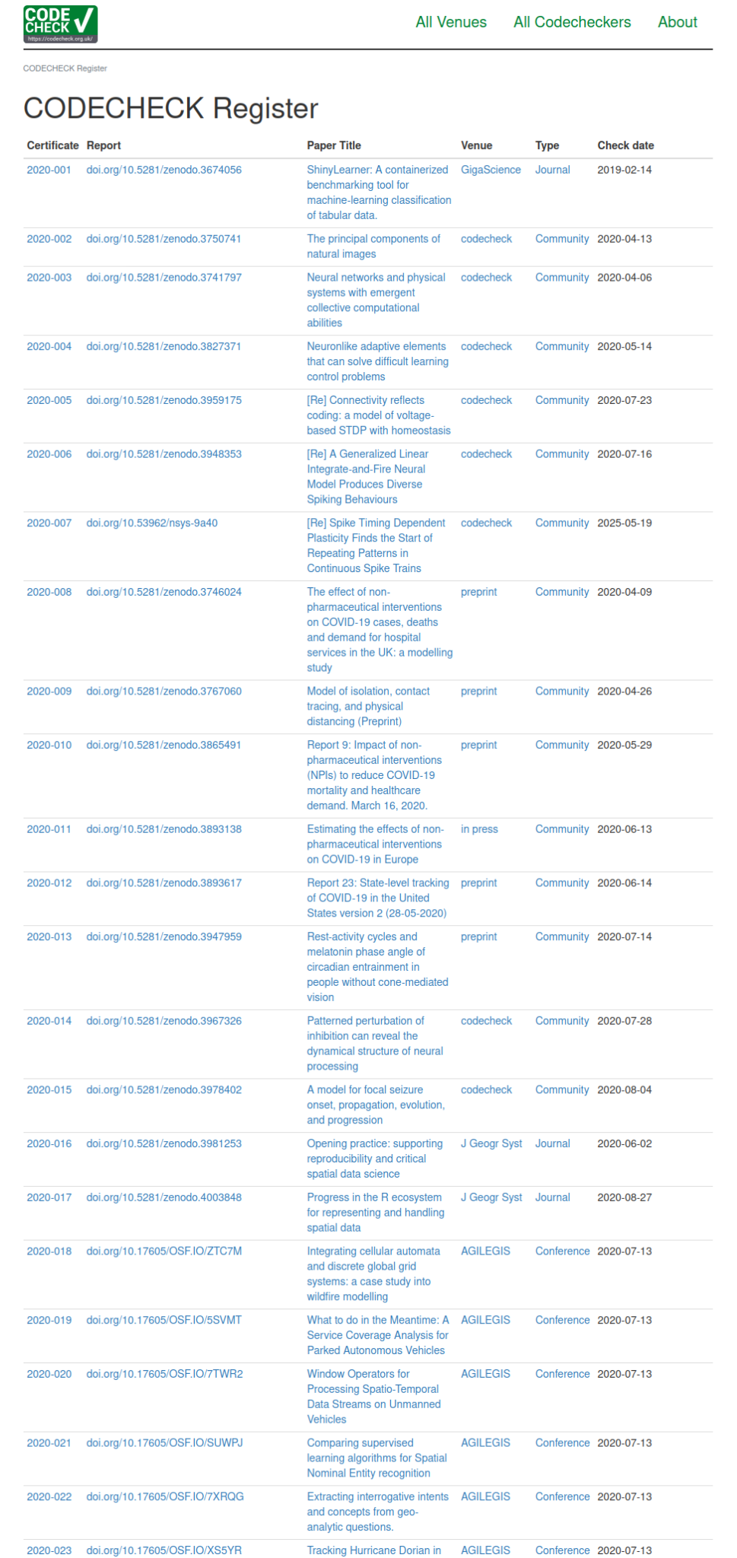
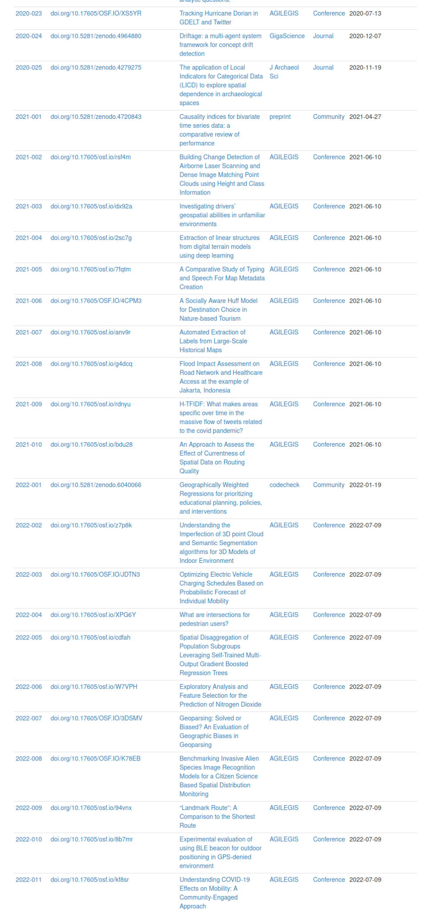
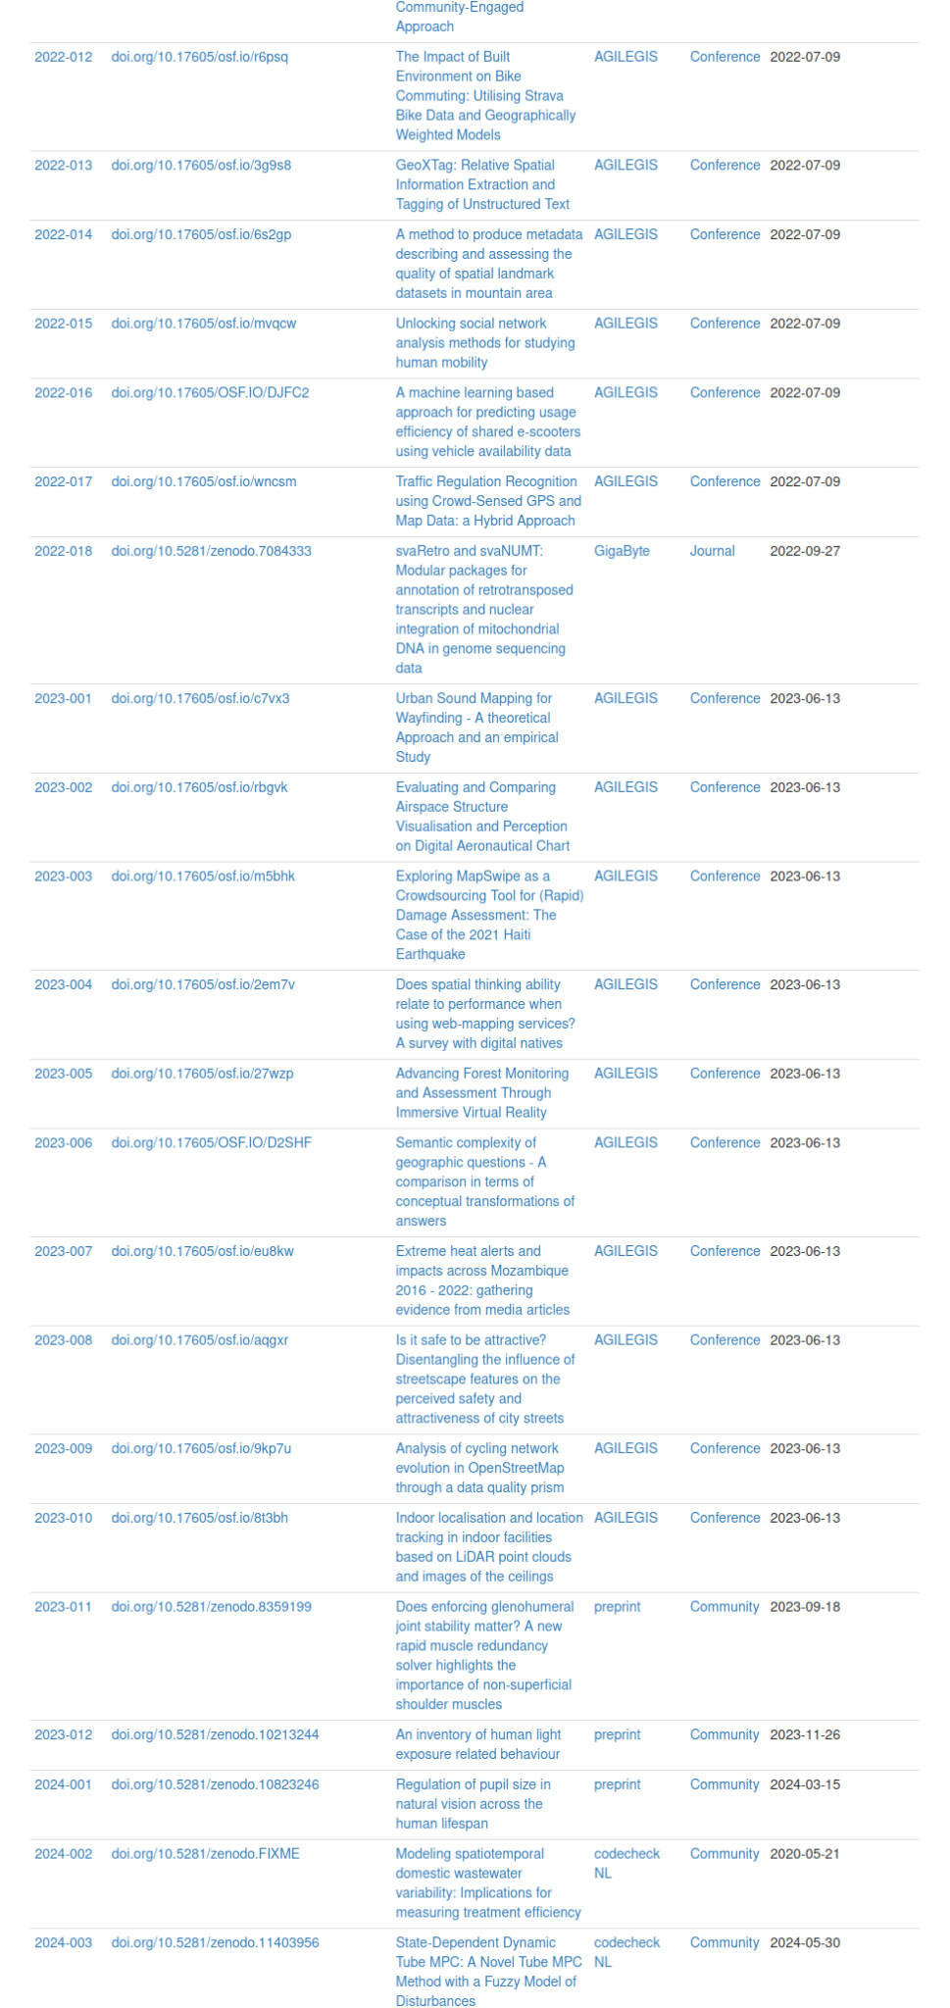
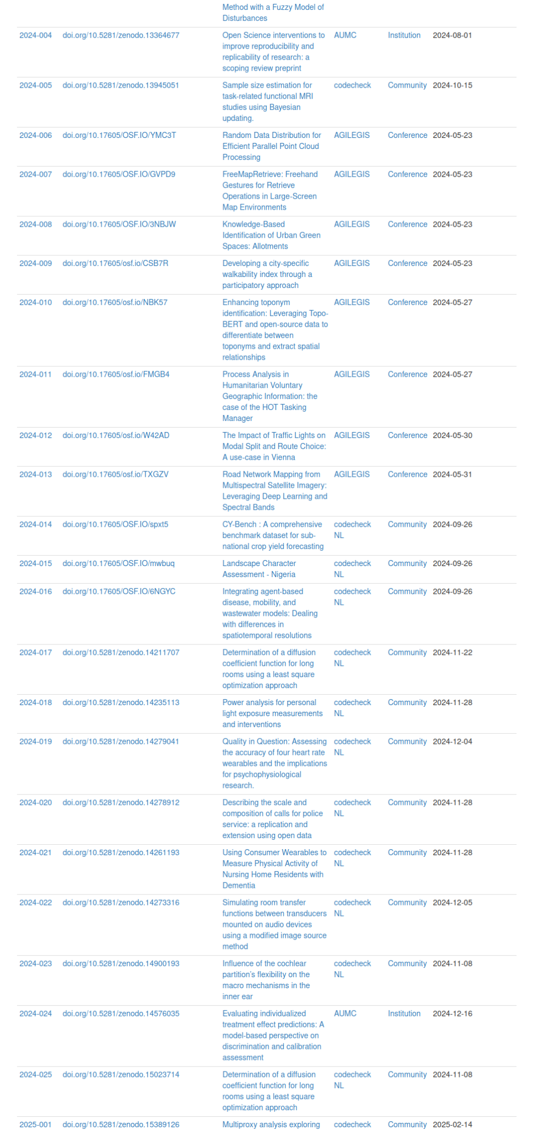
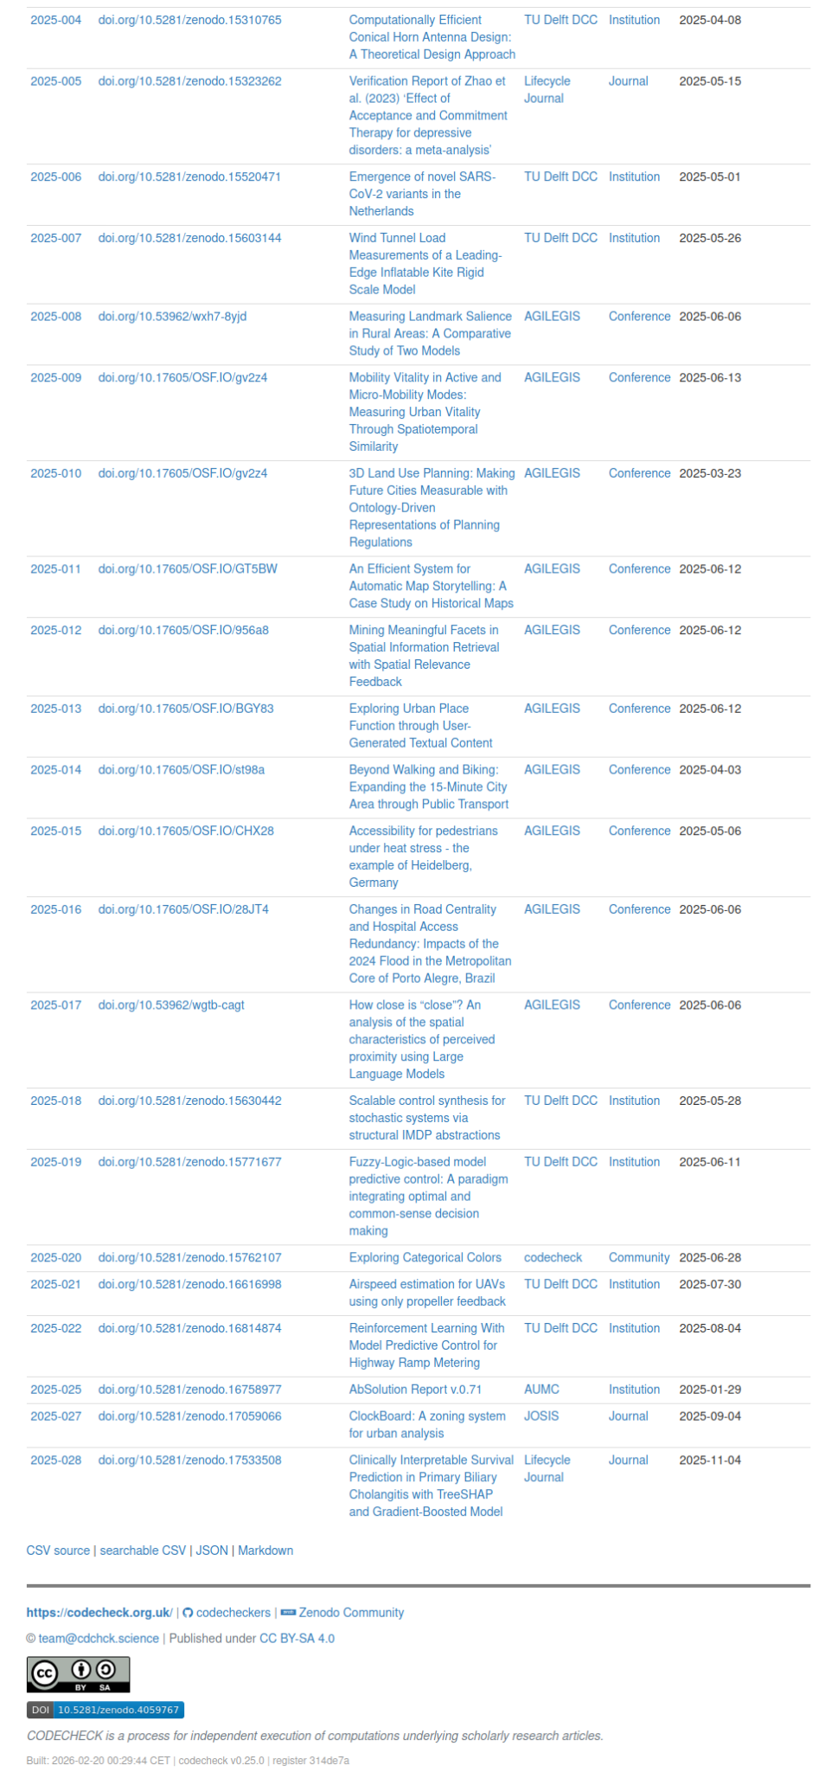
Your work here
https://codecheck.org.uk/register/

